Slide 1
Growth mindset
Parent event 10.9.15

Slide 2
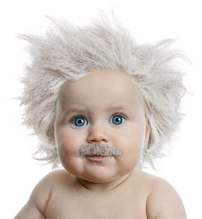
Born SMART….?
Am I smart?
Notes:
What do you think?
What do we need pupils to think you think?

Slide 3
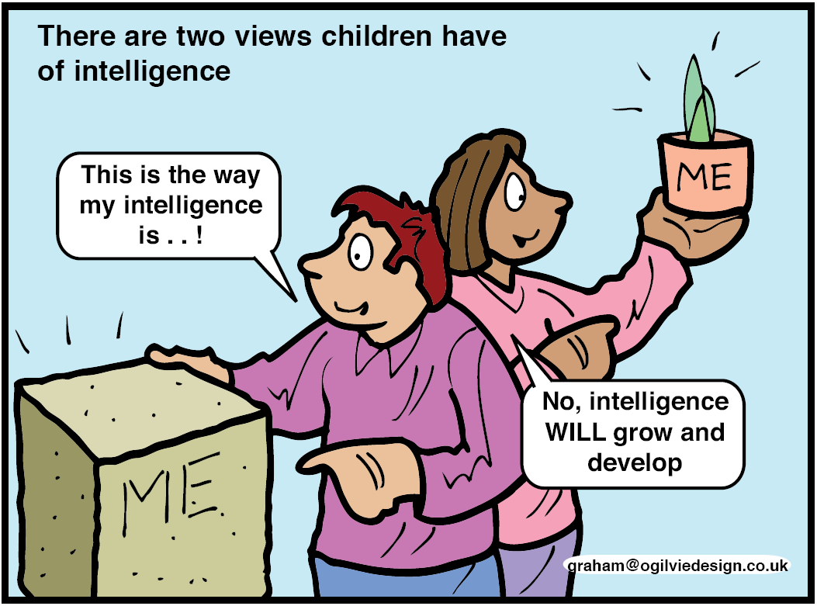

Slide 4
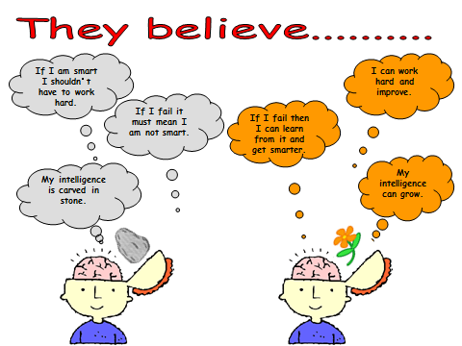

Slide 5
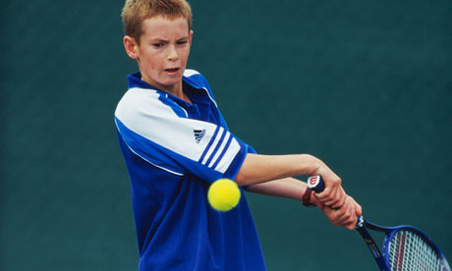
A GIFT? HARD WORK AND SACRIFICE?
Starting playing tennis aged 2.
Practised 5 days a week; every week.
By aged 5 playing in tournaments for under 10s.
By 8 he was allowed to play against adults in competitions.
Had few friends in secondary school and trained in all of his spare time.
Aged 15 asks his mum to move to Barcelona so he can be trained with the world’s best.
Notes:
“Gifted” musicians are “gifted” because the better they get, the harder they work:

Slide 6
http://www.bbc.co.uk/iplayer/episode/b06b95n6/dragons-den-series-13-episode-9

Slide 7
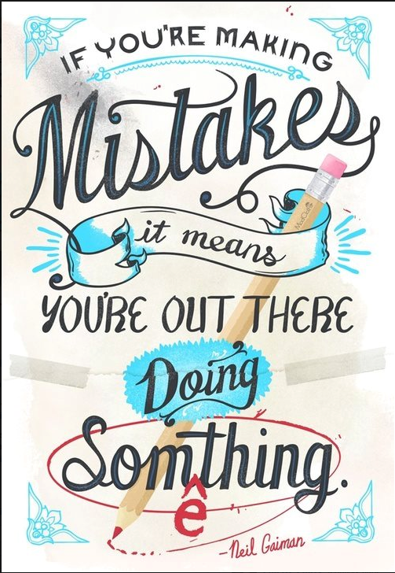

Slide 8

Notes:
A short video to really leave you understanding my vision for introducing a growth mindset at Wickham

Slide 9
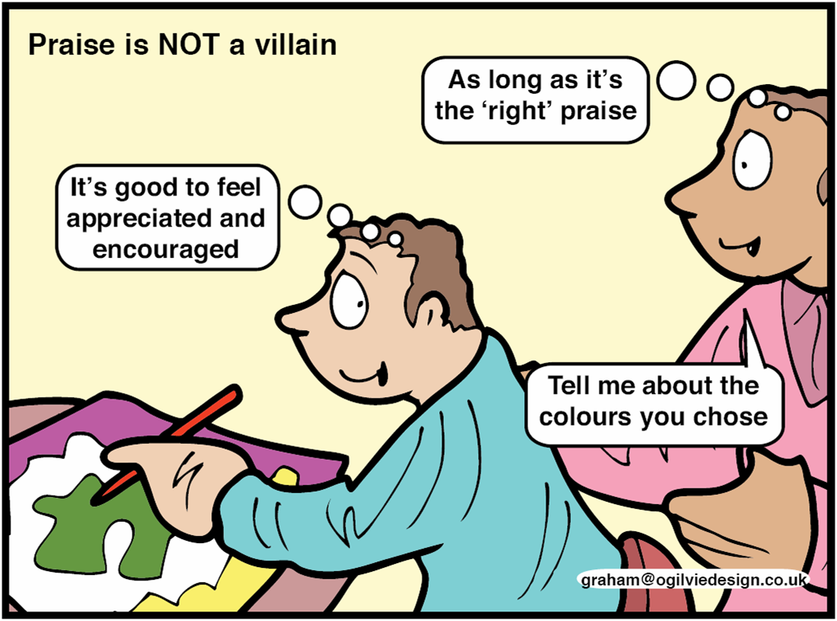
Praise is not a villain

Slide 10
Growing learners
Praise
Daily texts
Capturing success

